Slide 1


VISIONFIT
1
VisionFit
MASTER EVERY MOVE,
WITH AI IN YOUR CORNER
START NOW

Slide 2
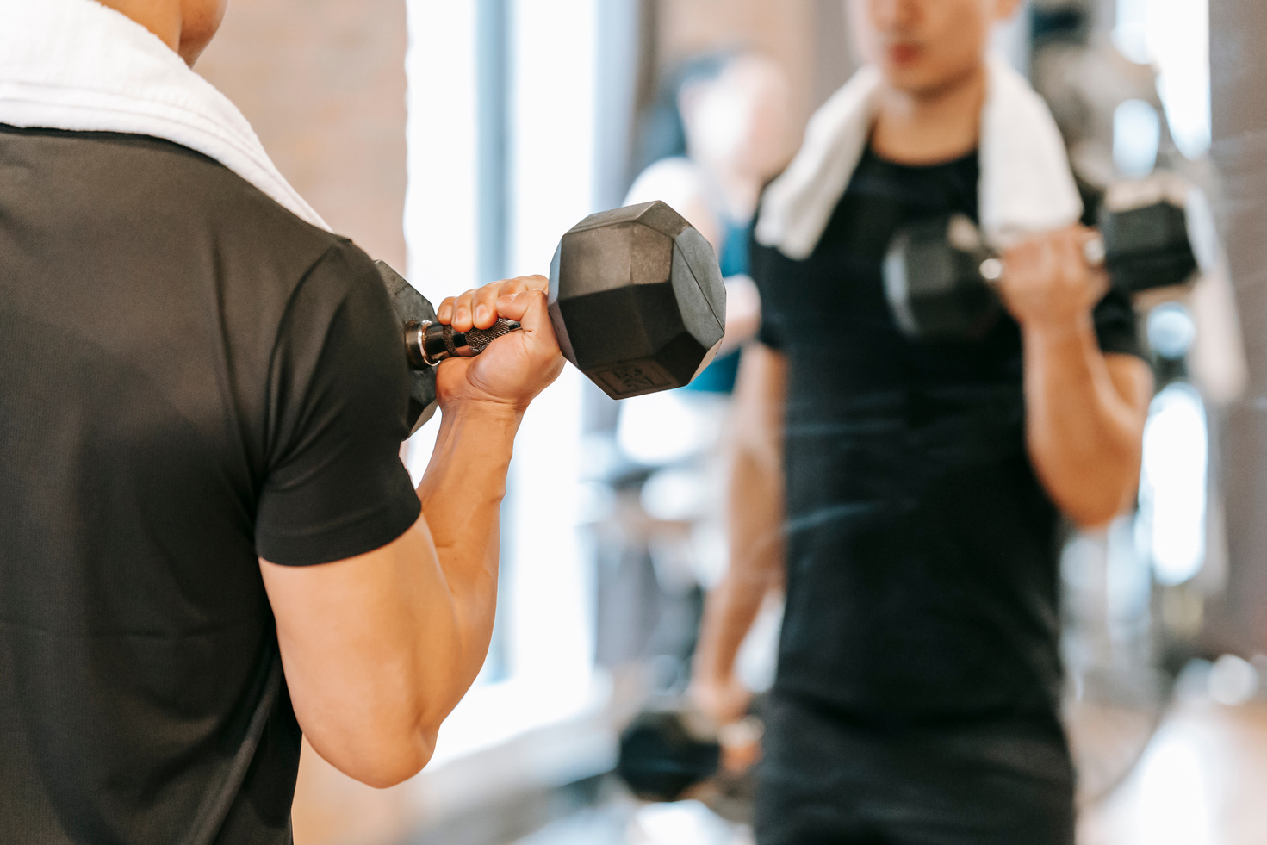


2
VISIONFIT
Contact
Problem Statement
Main Problem
The Gap
Why It Matters
Many people struggle with maintaining proper exercise form without professional guidance, which leads to poor results
Personal trainers are effective but can be expensive and not accessible to everyone.
Poor form risks injury and reduces the effectiveness of workouts.

Slide 3

VISIONFIT
3
Solution
VisionFit
A smart fitness app using AI-powered real-time posture detection.
Computer Vision
Pose estimation (e.g., Mediapipe)
Virtual Trainer
Provides live feedback, progress tracking, and personalized corrections

Slide 4

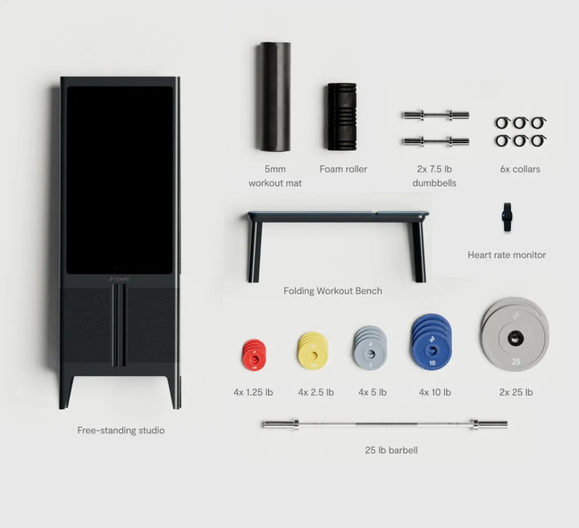
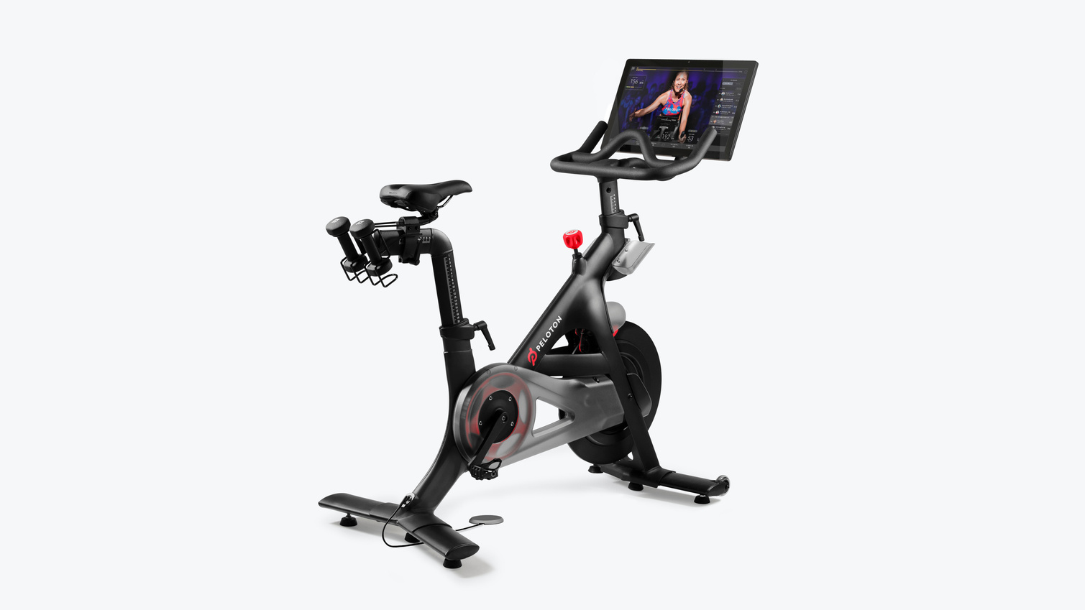
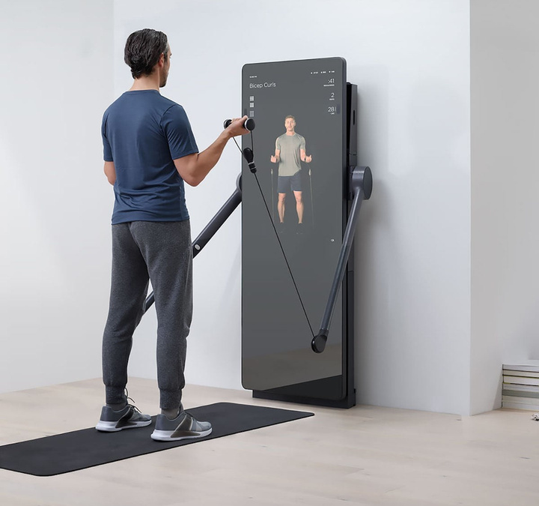
Competitors
4
VISIONFIT
Contact
TempoFit
Peloton
Mirror

Slide 5
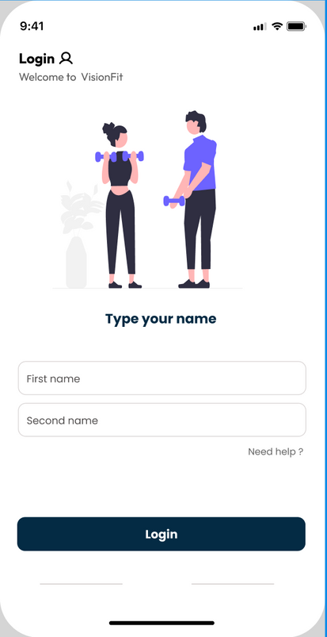
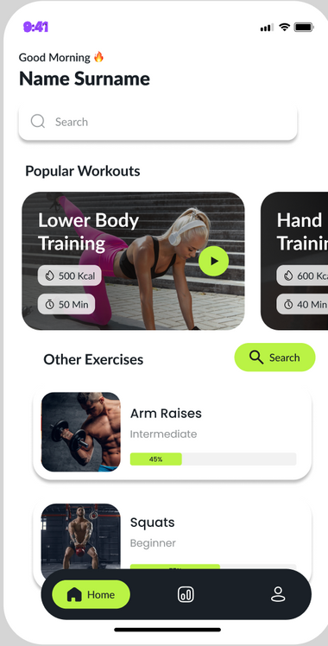
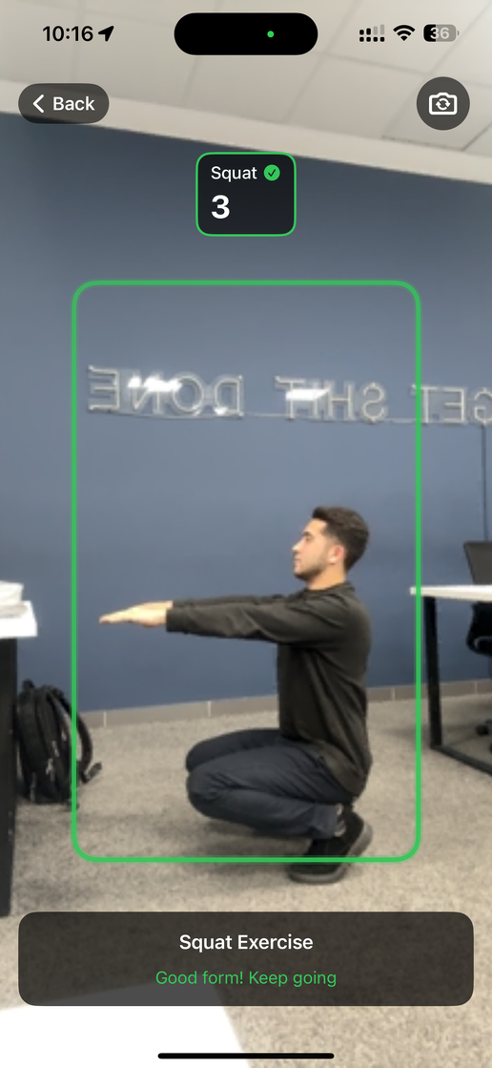
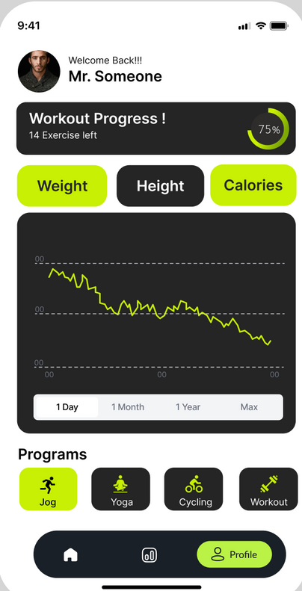
VISIONFIT
5
Product Demo

Slide 6

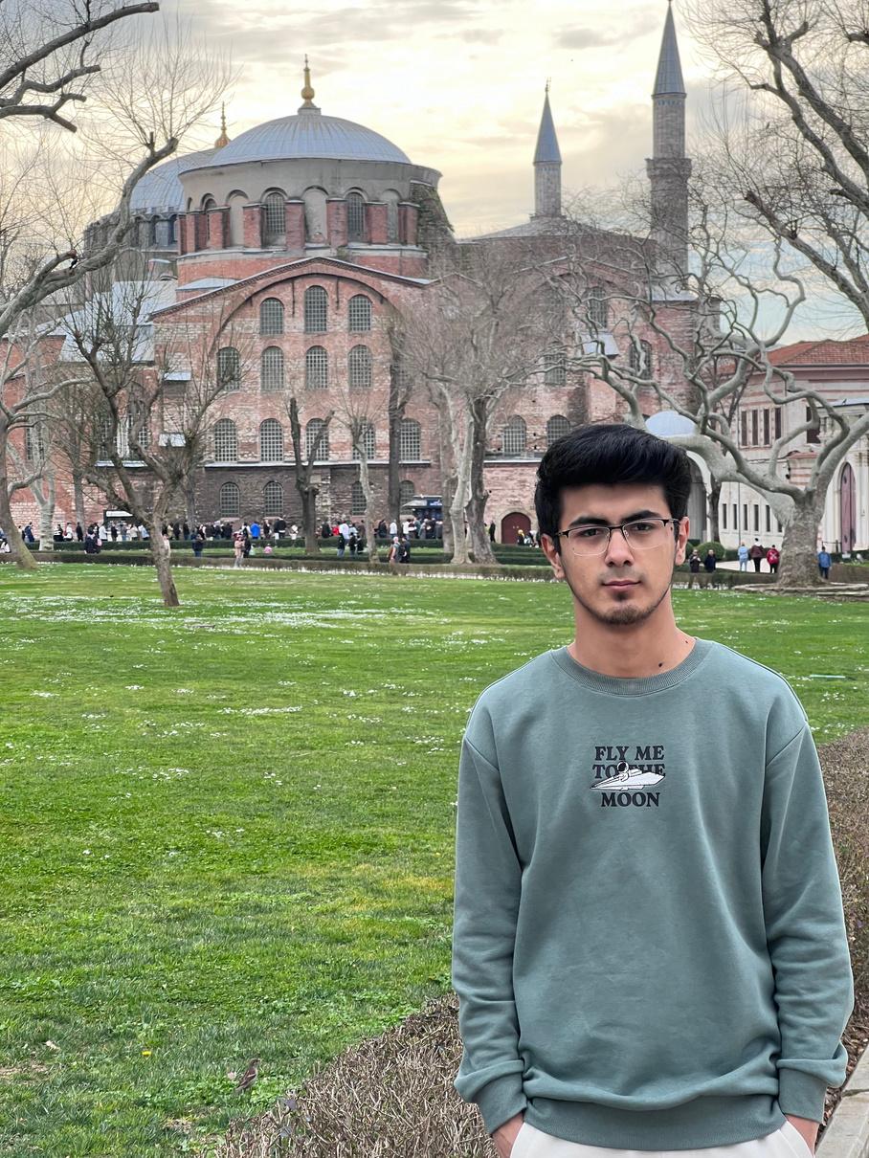

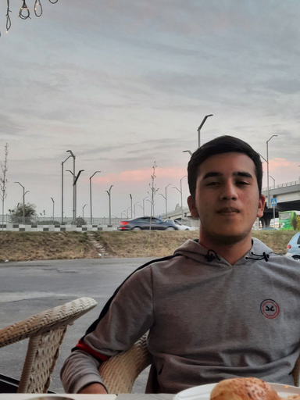
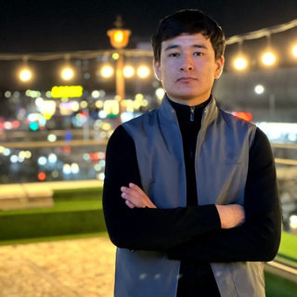


Team Members
6
VISIONFIT
Contact
DONIYORBEK IBROKHIMOV
CTO
Developed iOS app, handled integration
SAYDULLO ISMATOV
ABDUMANNOB MUYDINOV
CEO
COO
Led AI model training, app design, set vision
Handled logistics and team scheduling
SUKHROB SOTIBOLDIYEV
CFO
Built financial plan, researched funding sources
KHUSAN RAKHMATULLAYEV
FARRUKHBEK PANJIYEV
CMO
CSO
Content, marketing strategy, research
Developed sales strategy, client targeting
JURABEK TOJIDDINOV
CHRO
Managed team coordination and ensured smooth communication among members.

Slide 7
VISIONFIT
7
CEO (Saydullo Ismatov)
Key Responsibilities
Research Focus
Research Sources
Define and communicate project vision and mission
Align team goals with long-term strategy
Lead competitor and market analysis
Identify potential partners, mentors, and stakeholders
Trends in AI fitness technologies
Competitor platforms (e.g., Freeletics, Fitbod, Tonal)
Feasibility of freemium business models in fitness apps
Long-term risk assessment and user adoption barriers
Industry Reports (McKinsey on Fitness Tech, Statista, etc.)
Case studies of fitness startups (Tonal, Peloton)
User feedback surveys and pilot testing

Slide 8


VISIONFIT
8
VisionFit Roadmap
Launch and Scalability
Release a polished version of VisionFit
Plan for updates and future scaling
05
Testing and Optimization
04
Conduct user testing for app usability
Optimize AI models for accuracy
03
Feature Expansion
Add more exercises to the app
Backend and Data Management
Concept and Initial Planning
Identify project goals and target users
Research technologies (Mediapipe, iOS, etc.)
02
Basic Prototype Development
Develop a simple iOS app
Implement exercise tracking for a single exercise (Current Stage)
01

Slide 9





VISIONFIT
9
CTO (Doniyorbek Ibrokhimov)

Slide 10
VISIONFIT
10
Remaining Work & Next Steps
Train & Optimize the New Model
Backend Development
01
Enhance real-time feedback accuracy by fine-tuning the classification model and improving exercise detection.
02
Implement and refine the backend to handle user authentication, profile management, and exercise data storage efficiently.
Final Integration
Thesis Writing & Documentation
03
Seamlessly connect the AI model with the iOS application, ensuring smooth performance and real-time feedback delivery.
04
Continue drafting and refining the project report, including methodology, implementation, and results analysis.

Slide 11
VISIONFIT
10
Remaining Work & Next Steps
Train & Optimize the New Model
Backend Development
01
Enhance real-time feedback accuracy by fine-tuning the classification model and improving exercise detection.
02
Implement and refine the backend to handle user authentication, profile management, and exercise data storage efficiently.
Final Integration
Thesis Writing & Documentation
03
Seamlessly connect the AI model with the iOS application, ensuring smooth performance and real-time feedback delivery.
04
Continue drafting and refining the project report, including methodology, implementation, and results analysis.

Slide 12
VISIONFIT
10
Remaining Work & Next Steps
Train & Optimize the New Model
Backend Development
01
Enhance real-time feedback accuracy by fine-tuning the classification model and improving exercise detection.
02
Implement and refine the backend to handle user authentication, profile management, and exercise data storage efficiently.
Final Integration
Thesis Writing & Documentation
03
Seamlessly connect the AI model with the iOS application, ensuring smooth performance and real-time feedback delivery.
04
Continue drafting and refining the project report, including methodology, implementation, and results analysis.

Slide 13
VISIONFIT
10
Remaining Work & Next Steps
Train & Optimize the New Model
Backend Development
01
Enhance real-time feedback accuracy by fine-tuning the classification model and improving exercise detection.
02
Implement and refine the backend to handle user authentication, profile management, and exercise data storage efficiently.
Final Integration
Thesis Writing & Documentation
03
Seamlessly connect the AI model with the iOS application, ensuring smooth performance and real-time feedback delivery.
04
Continue drafting and refining the project report, including methodology, implementation, and results analysis.

Slide 14
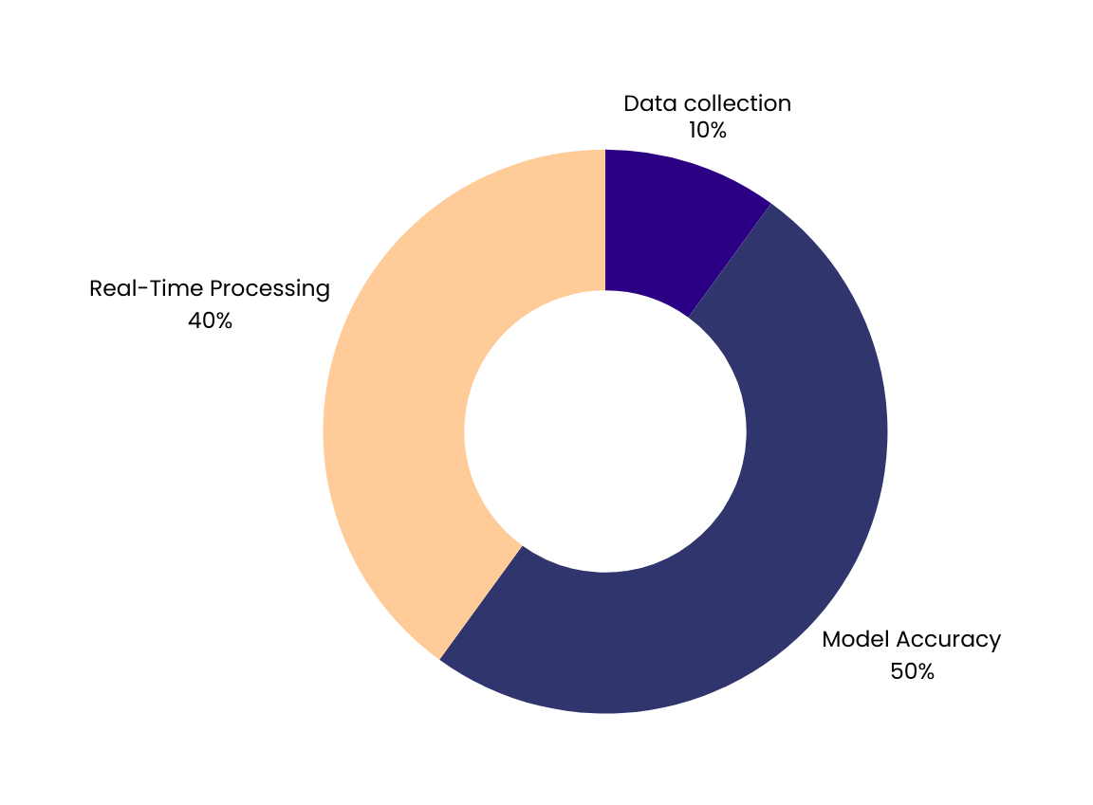
VISIONFIT
11
Challenges
Data Collection Complexity: Ensuring accurate labeling for better training.
Model Accuracy: Need for improved detection and feedback precision.
Real-time Processing: Optimizing inference time on mobile devices.
CONTINUE

Slide 15
VISIONFIT
12
COO (Abdumannob Muydinov)
Execution plan
Research Focus
01
Develop Efficient Workflows & Processes
→ Implement SOPs for app updates, AI voice command calibration, and real-time feedback tuning.
Identify & Mitigate Operational Risks
→ Use risk matrices for data breaches, user dropout rates, and supply chain delays.
02
Process Optimization
→ Ensure seamless integration of AI, voice control, and real-time workout tracking in VisionFit.
Supply Chain & Logistics
→ Build a scalable procurement and distribution system for portable fitness devices and accessories.
Operational Research strategy
Operational Risk Management
→ Mitigate risks related to device failures, AI model errors, and user privacy regulations (e.g., GDPR).
Team & Resource Management
→ Align cross-functional teams (AI, design, fitness content, support) for lean, on-time product delivery.
03
Benchmarking Studies
→ Compare operational KPIs with companies like Peloton and Tonal (e.g., user retention, logistics turnaround).
Use of Frameworks (Lean, Six Sigma, Agile)
→ Lean to minimize waste in production; Agile to iterate on app features; Six Sigma for QA consistency.

Slide 16
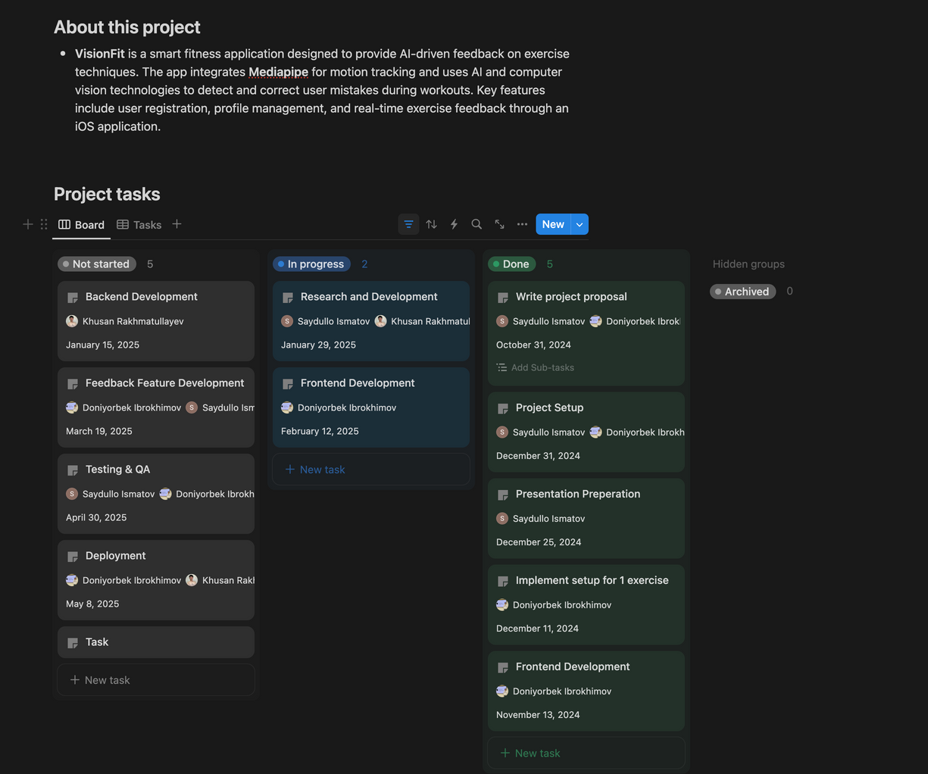


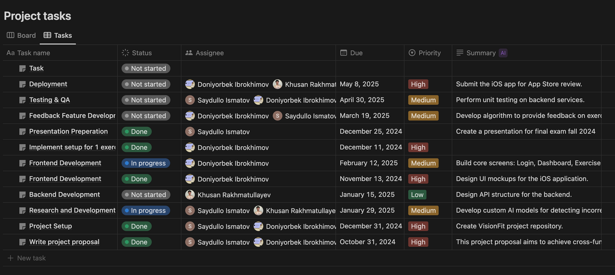
VISIONFIT
13

Slide 17
VISIONFIT
14
CMO (Khusan Rakhmatullayev)
Key Responsibilities
Research Focus
01
Defined target audience personas (gym-goers, fitness beginners, physiotherapy clients)
Created branding strategy (tagline, logo, and value proposition: "Fix Your Form, Save Your Gains")
Designed social media campaigns and outreach plans
02
Competitor analysis: Freeletics, Fitbod, Tonal
Social media and ad trends on TikTok, Instagram, and YouTube Shorts
Performance of viral fitness campaigns (e.g., "AI coach challenge")
Content creation strategies from fitness influencers
Key Contributions
Research Sources
03
Developed the marketing funnel for user acquisition (awareness → interest → trial → conversion)
Created brand messaging and designed visual identity
Helped prepare promo materials and the pitch deck
Coordinated with dev team for feature naming and UX alignment
Drafted early email campaigns and fitness community posts
04
Google Trends & TikTok Creative Center
Case studies on Peloton and Nike Training Club launches
SEMrush & Meta Ads Library
Canva, Figma, and Adobe tools for content creation
Surveys and feedback from early testers

Slide 18

VISIONFIT
15
Launch Channels:
Go-To-Market Strategy
01
TikTok/IG campaigns
Partner with gyms and influencers
Attend fitness expos and demo events
Early Traction:
02
Working iOS prototype
Interest from local gyms and trainers

Slide 19
VISIONFIT
16
CFO (Sukhrob Sotiboldiyev)
Key Responsibilities
Research Focus
01
Developed VisionFit’s financial model based on a freemium strategy.
Designed revenue streams from monthly user subscriptions and B2B licensing for gyms.
Conducted research on initial funding requirements and potential financing sources (grants, investors).
Evaluated financial risks and proposed cost optimization strategies to maximize profit margins.
02
Best practices for building financial models in early-stage startups.
Monetization strategies in the fitness tech industry (e.g., Fitbod, Freeletics).
Pros and cons of subscription-based and licensing revenue models.
Strategies for attracting external funding (e.g., angel investors, innovation grants).
Key Contributions
Research Sources
Set the monthly subscription price at $9.99 after benchmarking against competitors.
Created multi-scenario financial forecasts (optimistic, realistic, pessimistic).
Built custom-tier pricing models for B2B licensing with fitness centers.
Identified cost-saving opportunities and proposed strategic allocation of funds.
Harvard Business Review articles on startup financial planning.
Market reports from Statista and McKinsey on fitness technologies.
Case studies of successful fitness tech companies like Peloton and Fitbod.
Sample startup pitch decks and investor expectations for financial metrics.
03
04

Slide 20
VISIONFIT
17
Business Model
Revenue:
Pricing Strategy:
Scalability
Freemium model: Basic access free; premium = AI feedback + custom plans
Gym integrations via B2B deals
Monthly subscription for users ($9.99)
Licensing for gyms (custom tiers)
Expand to Android, VR, corporate fitness

Slide 21
VISIONFIT
17
Business Model
Revenue:
Pricing Strategy:
Scalability
Freemium model: Basic access free; premium = AI feedback + custom plans
Gym integrations via B2B deals
Monthly subscription for users ($9.99)
Licensing for gyms (custom tiers)
Expand to Android, VR, corporate fitness

Slide 22
VISIONFIT
17
Business Model
Revenue:
Pricing Strategy:
Scalability
Freemium model: Basic access free; premium = AI feedback + custom plans
Gym integrations via B2B deals
Monthly subscription for users ($9.99)
Licensing for gyms (custom tiers)
Expand to Android, VR, corporate fitness

Slide 23
VISIONFIT
18
CSO (Farrukh Panjiyev)
Marketing Strategy:
To successfully promote the AI-powered gym exercise monitoring system, the strategy will focus on targeting gym owners, fitness centers, personal trainers, and physiotherapy clinics through a mix of direct outreach, social media campaigns, and live product demonstrations. The product will be positioned as an innovative solution for preventing workout injuries and improving gym member performance using real-time AI feedback. Key marketing activities will include launching viral video campaigns on platforms like Instagram, TikTok, and YouTube under the theme “Fix Your Form, Save Your Gains”, collaborating with fitness influencers, and participating in fitness industry expos. Success will be measured by demo requests, client conversions, social media engagement, and new partnership deals.

Slide 24


VISIONFIT
19
Market Opportunity
Target Market:
Fitness tech users, gyms, physiotherapists.
Market Size
Global fitness app market projected to reach $1M by 2030.
User Personas
Gym newbies needing guidance
Athletes avoiding injuries
Physio patients needing rehab

Slide 25
VISIONFIT
20
CHRO(Jurabek Tojiddinov)
Talent Strategy & Culture Development
HR Analytics & Workforce Planning
01
Develop a People-First Strategy aligned with VisionFit’s growth.
Foster a performance-driven culture through regular feedback loops and OKRs.
Design and implement employee development programs (e.g., leadership training, skill workshops).
Promote a culture of diversity, inclusion, and well-being
02
Build data-driven dashboards to monitor hiring efficiency, retention, and engagement levels.
Leverage predictive analytics to forecast hiring needs and skill gaps.
Align workforce planning with product and market roadmap.
Recruitment & Employer Branding
Automate HR workflows using tools like BambooHR or HiBob.
Ensure compliance with labor laws and international standards (e.g., GDPR).
Create policies for remote/hybrid teams, performance reviews, and equity allocation.
03
Lead a strategic hiring process for cross-functional teams (AI, Product, Design, Support).
Strengthen employer branding via social media, tech events, and employee advocacy.
Build partnerships with universities and bootcamps for early talent acquisition.
04

Slide 26


VISIONFIT
21
Conclusion
Next Milestone: Finalize model and test real-world usability.
Future Potential: Expand to more exercises and fitness routines.
READ MORE

Slide 27

VISIONFIT
22
Thank you For Attention
MASTER EVERY MOVE,
WITH AI IN YOUR CORNER
SEE YOU

